Slide 1


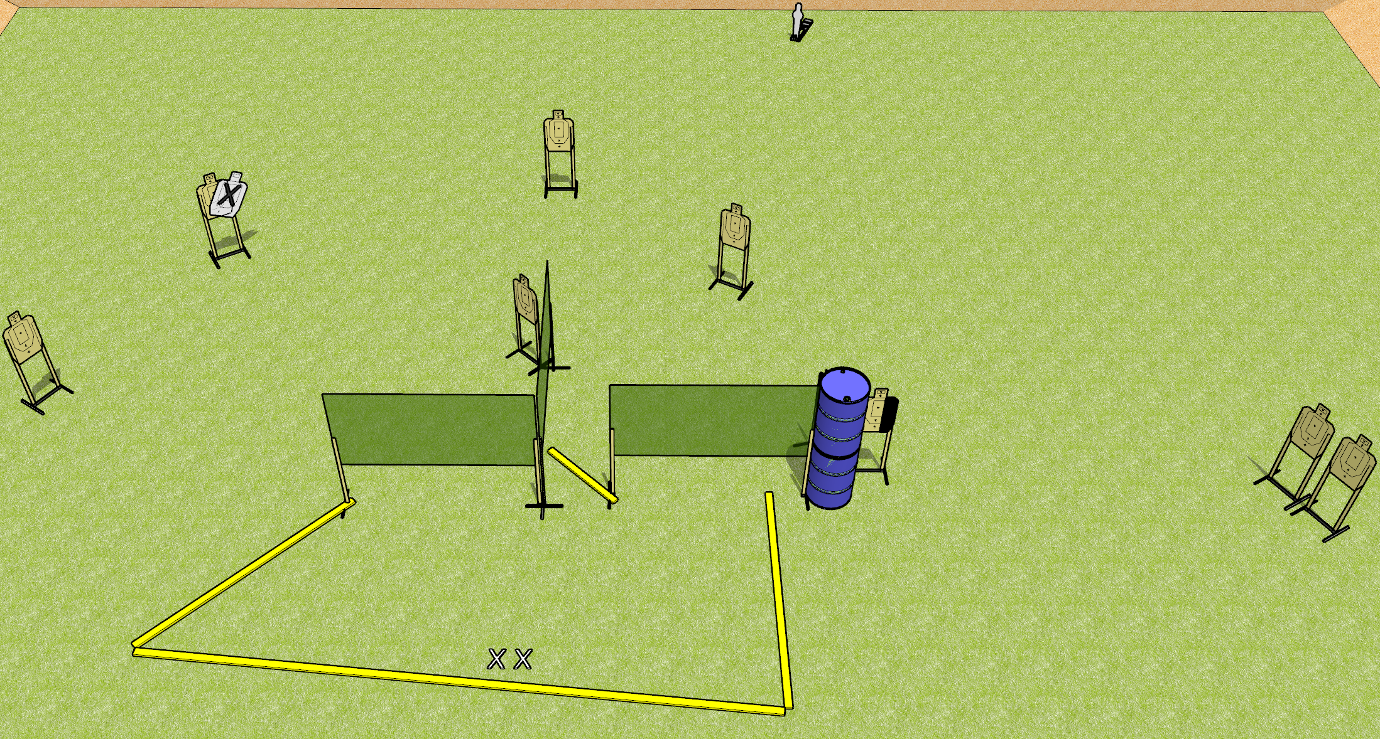
 | Dothan Gun Club – USPSA Match Thrown Down Course Designer : Drew Coleman
19 rounds 9 USPSA targets 1 mini popper
Equipment List 5 wall feet 1 medium or short fault line

Slide 2
Thrown Down
Written Stage Briefing
Thrown Down is a 19 round, 95 point, Comstock medium course. There are 9 USPSA targets and 1 mini popper. The best 2 hits on paper will score, and steel must fall to score. The start signal is audible.
Handgun start position is both feet on X’s, wrists below belt. Handgun is unloaded and holstered.
PCC start position is both feet on X’s. Unloaded carbine is held with both hands, stock on belt, safety on.
On start signal, engage targets as they become available from within the shooting area.

